Slide 1
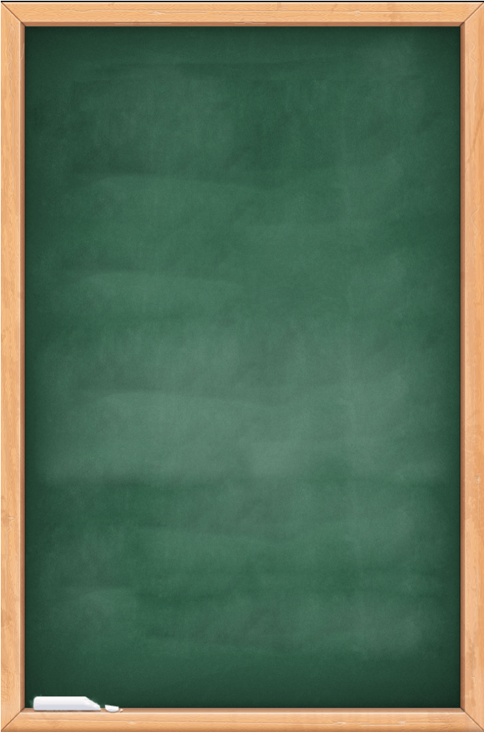

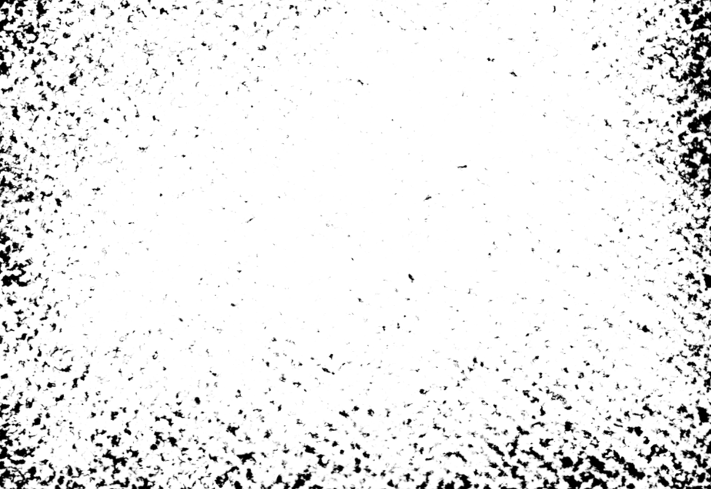
Students Learn to Cheat
Group members －－－－－－－－－－－－－－－
余思彤 para.1-3 曾钰麟 para. 4-5 吴芓璇 para. 6-7 容逸朗 para. 8-9 邓咏珊 para. 10-12

Slide 2
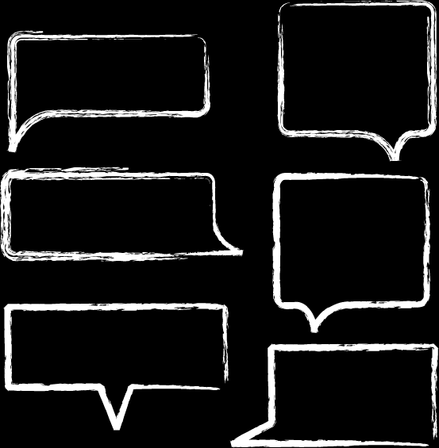
Paragraph 1 to 3

Slide 3
Cheating is on the rise in US schools, with attitudes on the part of students changing and the Internet serving as a primary.
In a recent survey of high school students in the United States, 74percent admitted that they had copied, used forbidden notes or helped someone else cheat on a test.72 percent acknowledged at least one incident of serious cheating on a written assignment.
In a survey of 2,200 students at 21 colleges conducted two years ago, one third of the students admitted to an incident of serious test cheating; about half admitted to cheating on written assignments. Research shows that the number of students engaging in the most serious forms of test cheating has doubled since the 1960s in high schools and college.

Slide 4
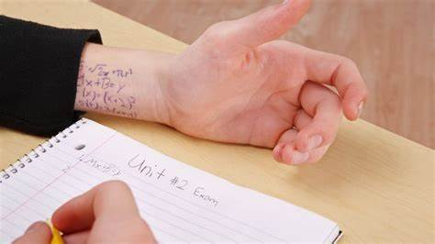

Vocabulary:
Forbid vt. 禁止不許 to say that sb.must not do sth.
acknowledge vt. 承認;確認;報償 To agree that sth. is true

Slide 5

Phrase:
serve as
Admit to
engage in...
充当...用作...;担任(职位)
承认；招认；招供；坦白
从事..., 参加...
Grammar:
Cheating is on the rise in US schools, with attitudes on the part of students changing and the Internet serving as a primary.
changing 为现在分词，构成“with + n. + 现在分词”复合宾语结构。

Slide 6
In a survey of 2,200 students at 21 colleges conducted two years ago, one third of the students admitted to an incident of serious test cheating; about half admitted to cheating on written assignments. Research shows that the number of students engaging in the most serious forms of test cheating has doubled since the 1960s in high schools and college. (賓語從句)
that 为连词，引导宾语从句。
engaging 为现在分词，作后置定语。

Slide 7
Paragraph 4 and 5

Slide 8
Students place the blame for this phenomenon on society and people in positions of authority. Consider the view of this high school junior from Massachusetts: ”To be successful in the world today people must cut corners, cheat, and backstab… Everybody cheats. Just not everybody gets caught.”
The view of a student at one of America’s most prestigious universities is even more telling. “In the real world, there are few rules and people cheat all of the time. It is a very competitive world, and when you are in a competitive environment, you do what it takes to win, whether it be cheating or whatever.”

Slide 9
Vocabulary:
Phenomenon n. 现象 an observed fact or situation, whose cause is in question
Backstab vt. 陷害 to attack someone verbally when that person is not present
Prestigious adj. 有声望的 inspiring respect and admiration; having high status

Slide 10
Phrase:
Place the blame (on sth.)
Cut corners
把责任推到…身上
取捷径

Slide 11
Paragraph 6 and 7

Slide 12

Vocabulary
While students have cheated for generations, the ease with which they are able to justify their behaviour by blaming it on others is a more recent and worrisome phenomenon. It’s even easier when they see teachers and administrators themselves accused of cheating, for example, those charged with improperly administering standardized math and reading tests in order to boost scores.
(
)

Slide 13
Vocabulary
Adding to the confusion, what students and teachers view as cheating often differs. Nowhere is this more confusing than with the use of the Internet. Some students view anything in the Internet as public information and feel free to save text from a website and “paste” it into an assignment without citing the source. Even when they know this is inappropriate, students believe they are well ahead of teachers when it comes to understanding the Internet, and they see little risk in plagiarizing.
(
)

Slide 14
Vocabulary
ease 容易 ; 悠闲 (n.) / 缓和 (v.) - ease up 放松 ​- with ease 轻易 - at ease 舒适，安逸
worrisome 令人不安的 (adj.) - vexatious, tight
administrator 管理人，行政官 (n.) - a person whose job is to manage and organize the public or business affairs of a company
improperly 不正确，不恰当地 (adv.) ​- in a way that is dishonest or morally wrong - in a way that is not right or appropriate for the situation
accuse 控告，谴责，非难 (vt.) - ​accuse of accuse sb. of sth.
Notes:
ease 容易 ; 悠闲 (n.) / 缓和 (v.) - lack of difficulty ​- the state of feeling relaxed or comfortable without worries, problems or pain
worrisome 令人不安的 (adj.) - that makes you worry
administrator 管理人，行政官 (n.) - a person whose job is to manage and organize the public or business affairs of a company
improperly 不正确，不恰当地 (adv.) ​- in a way that is dishonest or morally wrong - in a way that is not right or appropriate for the situation
accuse 控告，谴责，非难 (vt.) - ​to say that somebody has done something wrong or is guilty of something

Slide 15
Vocabulary
administer 管理 ; 给予 ; 执行 (v.) - to manage and organize the affairs of a company, an organization, a country, etc.
standardized 标准的，定型的 (adj.) - to make objects or activities of the same type have the same features or qualities - to make something standard
nowhere 无处，到处都无 (adv.) - not in or to any place
paste 黏，贴 (vt.) / 糊，浆糊 (n.) - paste up 用漆、张贴
cite 引用 ; 传唤 ; 表彰 (vt.) - cite for 因…传讯，为…而引用
inappropriate 不适当、不相称的(adj.) - be inappropriate for
plagiarize 剽窃，抄袭 (v.) - to copy another person’s ideas, words or work and pretend that they are your own
Notes:
administer 管理 ; 给予 ; 执行 (v.) - to manage and organize the affairs of a company, an organization, a country, etc.
standardized 标准的，定型的 (adj.) - to make objects or activities of the same type have the same features or qualities - to make something standard
nowhere 无处，到处都无 (adv.) - not in or to any place

Slide 16
Paragraph 8 to 9

Slide 17
08
Students also receive mixed messages at home.
For example, in a recent survey, one in five high school students acknowledged that they had submitted for credit work that had been done primarily by their parents.
(宾语从句)
(定语从句)
While such assistance might be appropriate in elementary school, parents who are doing assignments for children in high school are sending a message that grades are the most important and how you achieve them doesn't matter.
(定语从句)
(同位语从句)
(主语从句)
Parents doing their children's homework will make the children think that grades are the most important thing.

Slide 18
08
credit (n.):
A unit of measurement of the value contributed by an educational course to a college degree.
primarily (adv.):
Mainly.
appropriate (adj.):
适当
Suitable or right for a particular situation or occasion.
elementary (adv.):
simple or easy; basic.

Slide 19
09
Of course, many of these attitudes are not new.
Cheating has always been a part of school.
What is worrisome is that increasingly students view education as just a hurdle that needs to be crossed to get to the next level, whether that's earning a diploma, gaining admission to college or graduate school or getting a job interview.
(主语从句)
(表语从句)
(定语从句)
(让步状语从句)
When education is viewed as simply a means to an end, it is not surprising that so many students cheat.
And for many, there's a sense of entitlement that they deserve to be at that next level.
(同位语从句)
If they have to cheat a bit to get there, so be it.
As the grade is a key to success, many people would like to cheat for good marks.

Slide 20
09
hurdle (n.):
A problem that you must solve or deal with before you can make progress.
diploma (n.):
文凭
A document given by a school, college, or university to show that you have successfully completed a course of study.
entitlement (n.):
权利
Something that you have a right to do or have, or the right to do or have something.
So be it:
Just do it.

Slide 21
Paragraph 10 to 12

Slide 22
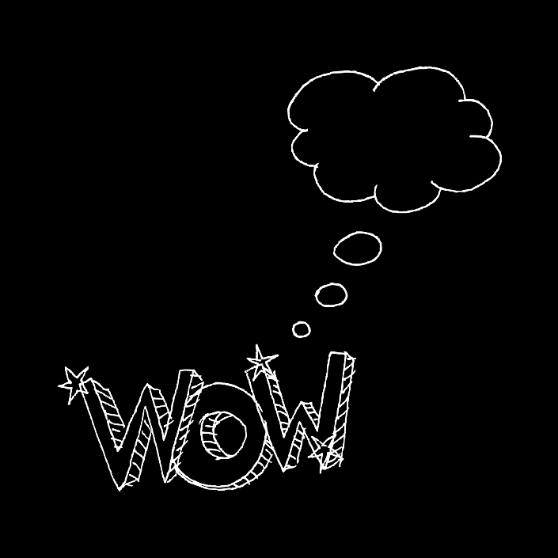
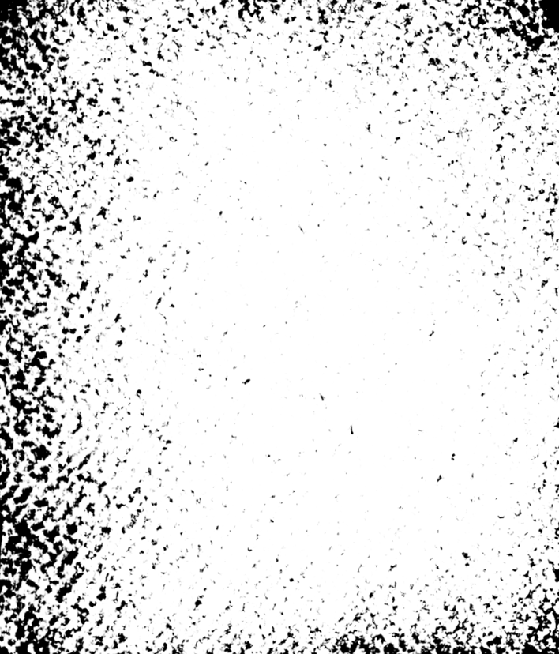
Main content
An increasing mumber of students and faculty are talking action.
Persuasion by teachers and parents is important to reduce cheating.

Slide 23
Words
bleak adj.
凄凉的；暗淡的
response n.
反应；回答
campus n. 校园
scandal n.
丑行；丑闻
convince vt. 使确信

Slide 24
Phrases
01
03
02
be willing to do sth
愿意/乐意做某事
eg.I am willing to help.
lack of
缺乏......
eg.I am lack of sleep every day in Tsinghua.
be frustrated with
对某人，某事感到失望
eg.I frustrated with my boyfriend.

Slide 25
Grammar
Students who are willing to work hard and be honest are becoming frustrated with the lack of response to high levels of cheating.
Relative Pronouns
Linking verb
Predicative

Slide 26
Thank you for your listening

